Slide 1
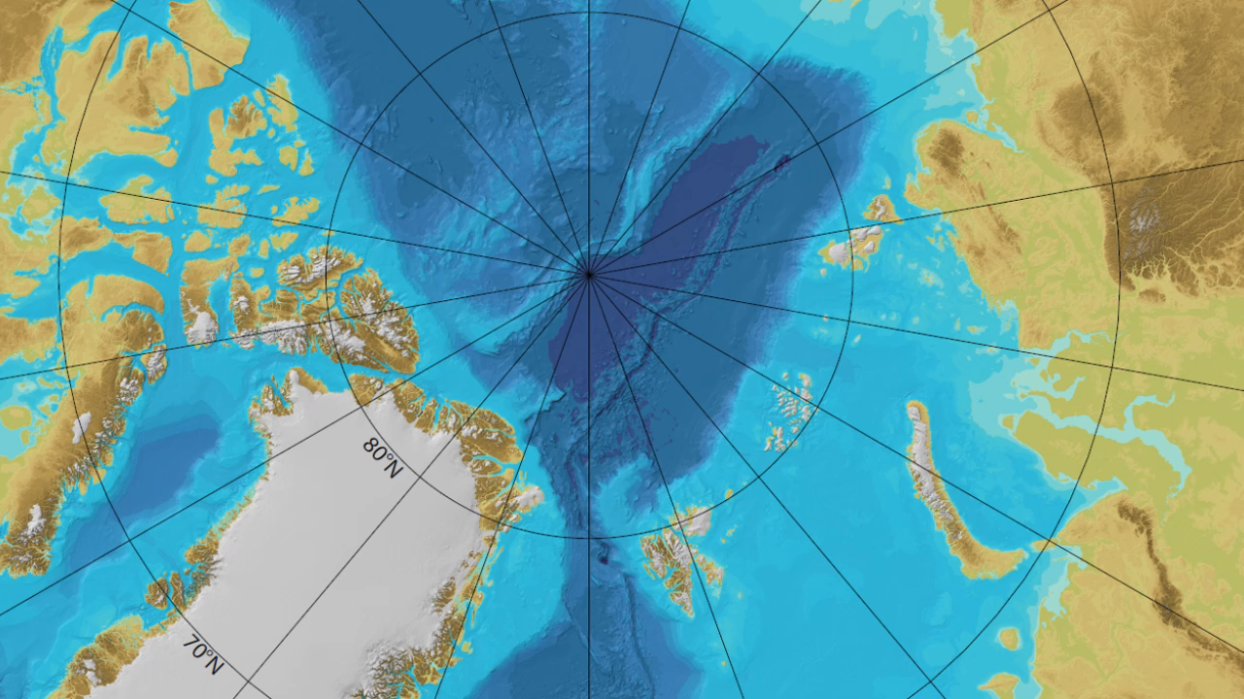
HIGH NORTH

Slide 2


Slide 3
